Slide 1

Introduction to CSCW and Related Conferences
Dr. Kori Inkpen
Microsoft Research

Slide 2

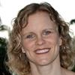


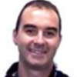
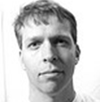


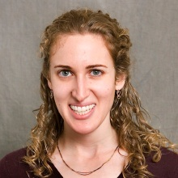

neXus Group
Video-Mediated Communication
Kori
Inkpen
Gina
Venolia
John
Tang
Sasa
Junuzovic
Aaron
Hoff
Computational
Social Science
Collaborative Search & Accessibility
Information
Visualization
Scott
Counts
Munmun
De Choudhury
Merrie
Morris
Nathalie
Henry Riche

Slide 3
My early CSCW publications
First CSCW rejection: 1994 (?)
Early CSCW publications: CHI 1995, CSCL 1995 & 1997
First CSCW publications:
Workshop paper & demo: CSCW 1998
Full paper + panel + workshop: CSCW 2000
Total CSCW publications: 13

Slide 4
ACM Conference on
Computer Supported Cooperative Work (CSCW)
ACM’s formal definition:
Is a premier venue for presenting research in the design and use of technologies that affect groups, organizations, and communities.
The development and application of new technologies continues to enable new ways of working together and coordinating activities.
It brings together top researchers and practitioners from academia and industry who are interested in both the technical and social aspects of collaboration.
http://dl.acm.org/event.cfm?id=RE169&CFID=127252792&CFTOKEN=32270650

Slide 5
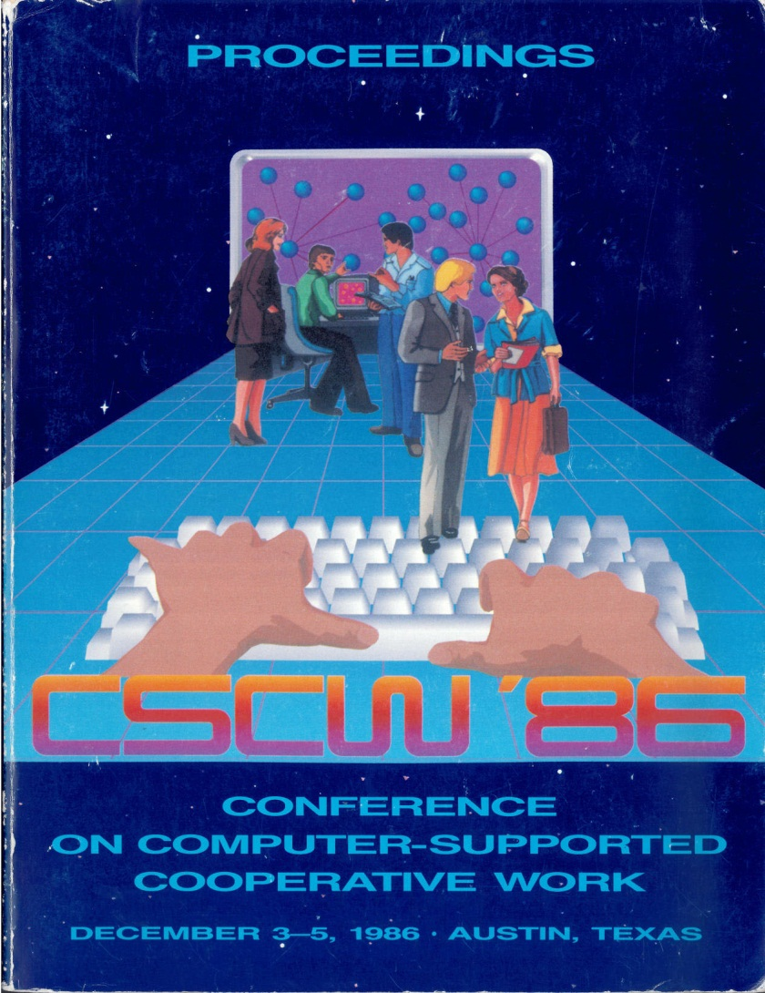
History of CSCW Conference
First conference 1986
Every other year through 2010
Every year starting 2011

Slide 6
CSCW Conference Over the Years (15)
1986: Austin, Texas (USA), Herb Krasner & Irene Greif
1988: Portland, Oregon (USA), Irene Greif
1990: Los Angeles, California (USA), Frank Halasz
1992: Toronto, Ontario (Canada), Marilyn Mantei & Ronald Baecker
1994: Chapel Hill, North Carolina (USA), John Smith, Don Smith & Thomas Malone
1996: Boston, Massachusetts (USA), Gary Olson, Judith Olson, & Mark Ackerman
1998: Seattle, Washington (USA), Steven Poltrock & Jonathan Grudin
2000: Philadelphia Pennsylvania (USA), Wendy Kellogg & Steve Whittaker
2002: New Orleans, Louisiana (USA), Elizabeth Churchill & Joe McCarthy
2004: Chicago, Illinois (USA), Gary Olson & Jim Herbsleb
2006: Banff, Alberta (Canada), Pamela Hinds & David Martin
2008: San Diego, California (USA), Bo Begole and David McDonald
2010: Savannah, Georgia (USA), Kori Inkpen & Carl Gutwin
2011: Hangzhou (China), Pamela Hinds, John C. Tang, & Jian Wang
2012: Seattle, WA (USA), Steve Poltrock and Carla Simone

Slide 7
Is it really only about Work??
From ACM:
  Although work is an important area of focus for the conference, technology is increasingly supporting a wide range of recreational and social activities. CSCW has also embraced an increasing range of devices, as we collaborate from different contexts and situations. http://dl.acm.org/event.cfm?id=RE169&CFID=127252792&CFTOKEN=32270650
Early CSCW conferences focused primarily on the “workplace” (with the exception of 3 papers in 1988)
Shift around 1998 / 2000 when we started seeing more papers focused on home, children, K-12 education, games, leisure, etc.
  1996 Workshop - Extending CSCW into domestic environments

Slide 8
CSCW 2013
The scope of CSCW includes, but is not limited to, social computing, technologically-enabled or enhanced communication, collaboration, information sharing, and coordination. It includes socio-technical activities at work, in the home, in education, in healthcare, in the arts, for socializing and for entertainment
  Social Computing
  Theories and models
  System design
  Empirical investigations
  Methodologies and toolkits
  Domain-specific social and collaborative applications
  Collaboration systems based on emerging technologies
  Crossing boundaries

Slide 9
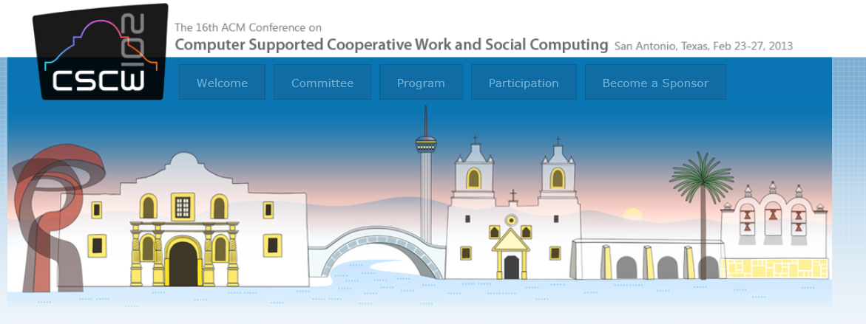
Interesting to note:

Slide 10
Reviews of CSCW Conference
Computer-Supported Cooperative Work: Its History and Participation (1994)
  Jonathan Grudin, IEEE Computer, 27 (5), 19-26.
Students: The Evolution of CSCW -- Past, Present and Future Developments (1997)
  David Crow, Sara Parsowith & G. Bowden Wise, SIGCHI Bulletin 1997, 29 (2)
Empirical research in CSCW – a Review of the ACM/CSCW Conferences from 1998 to 2004 (2007)
  Jacques Wainer & Claudia Barsottini, Journal of the Brazilian Computer Society, v. 13, p. 27-36, 2007

Slide 11
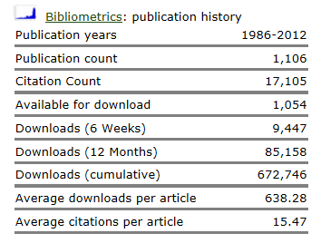
CSCW Bibliometrics & Other Data
http://dl.acm.org/event.cfm?id=RE169&CFID=127252792&CFTOKEN=32270650

Slide 12
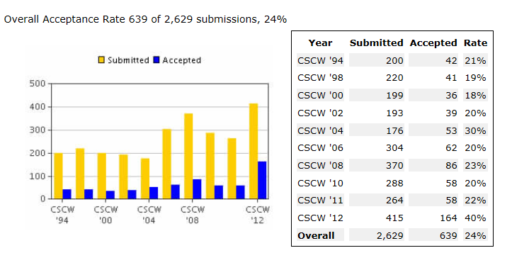
Acceptance Rates

Slide 13
Number of Parallel Tracks
1986 – 1990 (3 conferences) – one track
1992 – 2002 (6 conferences) – two tracks
2004 – 2011 (5 conferences ) – three tracks
2012 – six tracks!

Slide 14
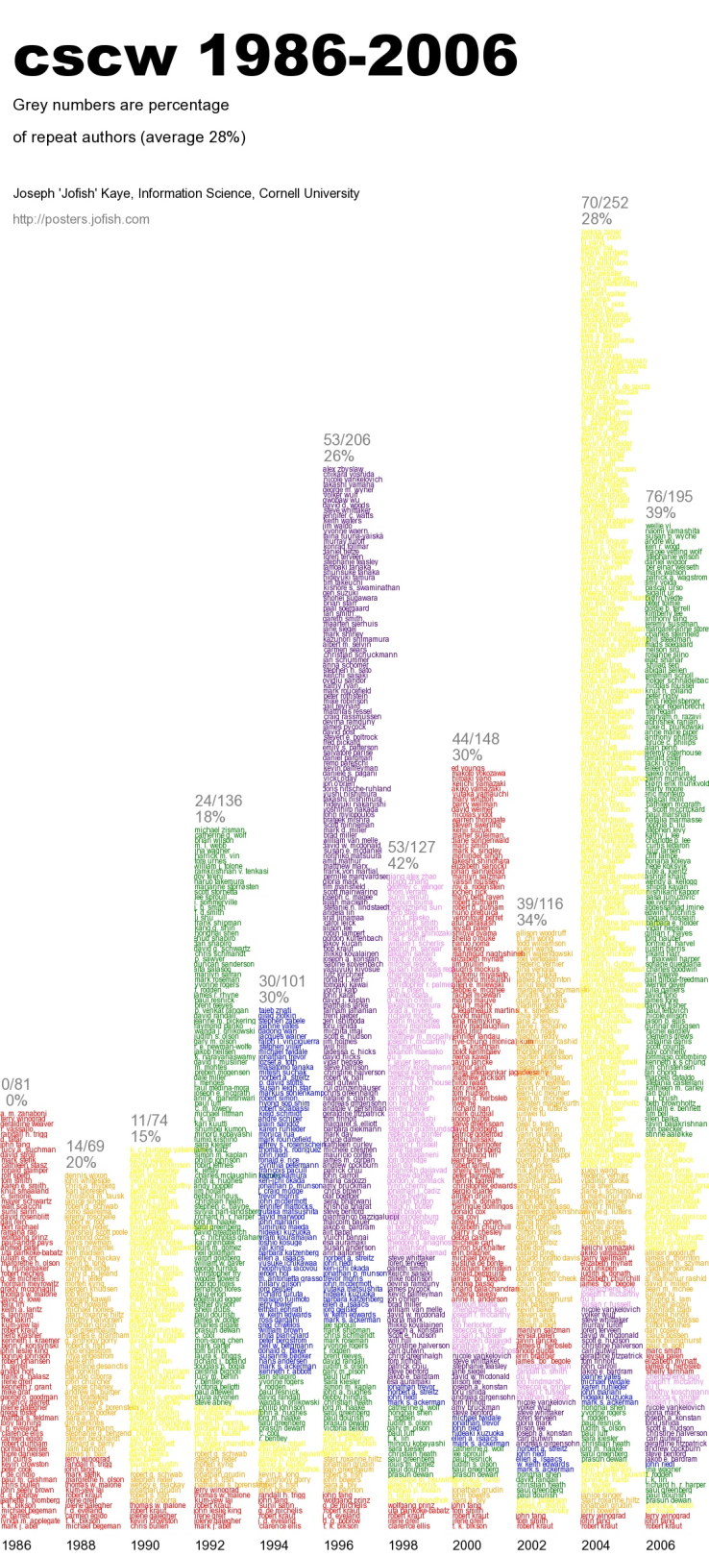
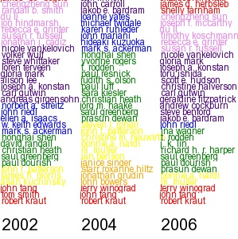
CSCW Authors

Slide 16
Approximate Attendance Numbers (by Country)
 | 2006 | 2008 | 2010 *start of annual conference & new time of year | 2011 *in China | 2012 *40% acceptance rate
TOTAL | 416 | 505 | 373 | 346 | 660
North America |  | 76.6% (387) | 80.4% (300) | 40.5% (140) | 76.5% (504)
Europe |  | 14.7 (74) | 11.0% (41) | 13.9% (48) | 14.4% (95)
Asia |  | 5.9% (30) | 6.7% (25) | 43.1% (149) | 7.7% (51)
Australia |  | 2.2% (11) | 0.8% (3) | 1.4% (5) | 0.5% (3)
South America |  | 0.6% (3) | 0.8% (3) | 0.5% (3) | 0.5% (3)
Africa |  | 0% (0) | 0.3% (1) | 0.3% (1) | 0.5% (3)

Slide 17
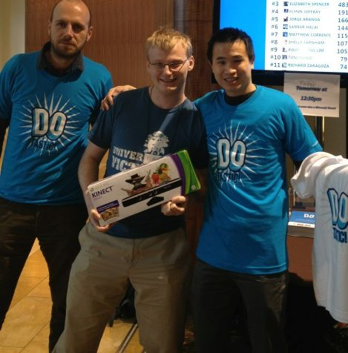
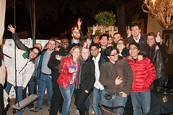
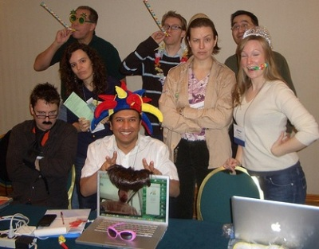
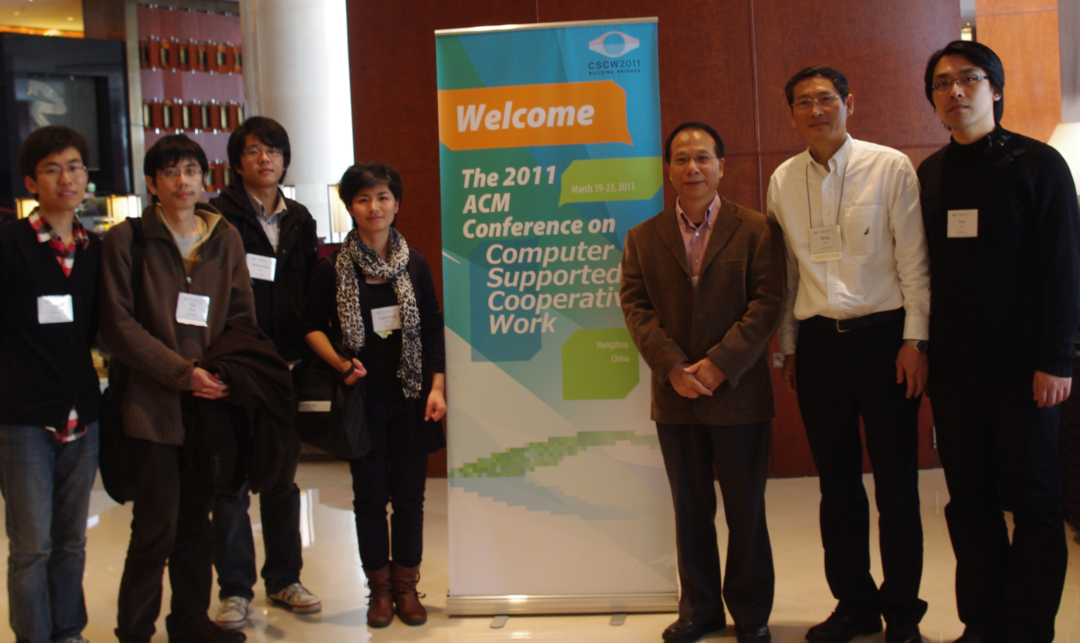
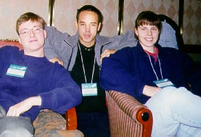
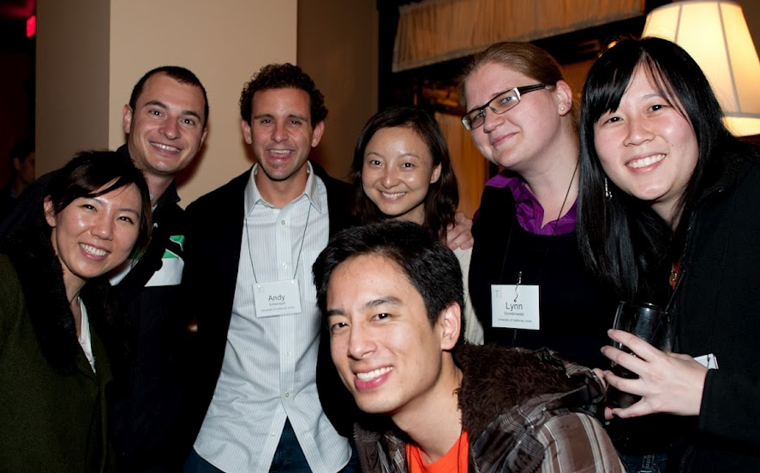
The Best Thing about CSCW ...

Slide 18
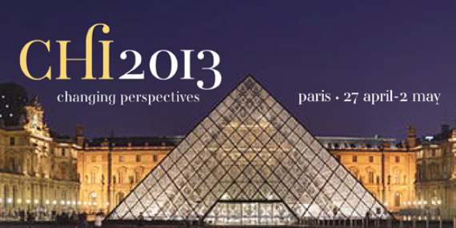
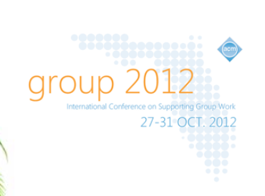

Related ACM Conferences
Notes:
Explain relationship between various conferences
Ubicomp 2011 in Beijing but website/logo doesn’t seem to be available

Slide 19
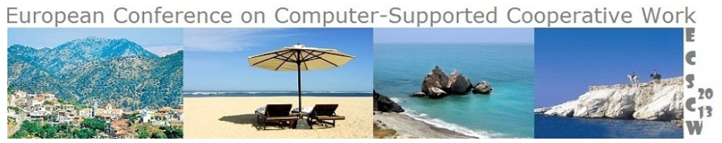


Other CSCW Conferences

Slide 20

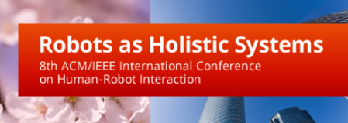
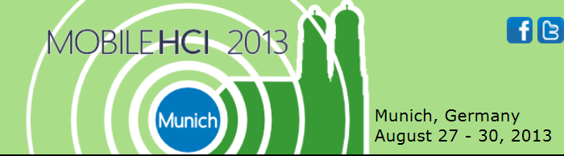

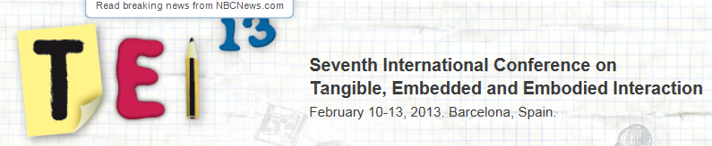
Other ACM Conferences
Notes:
Explain relationship between various conferences
Ubicomp 2011 in Beijing but website/logo doesn’t seem to be available

Slide 21
CSCW 2014
Conference Chairs:
  Sue Fussell (Cornell)
  Wayne Lutters (University of Maryland)
Papers Chairs:
  Meredith Morris (Microsoft Research)
  Madhu Reddy (Penn State University)
Other Info (tentative, not confirmed):
  Papers Due Date: May/June 2013 (?)
  Location: Miami, Florida (?)
  Dates: Feb. 2014

